Slide 1



AMS Compassion and Artificial Intelligence
Fellowship program
Small Grant program
Information Webinar
November 22, 2023

Slide 2

Land Acknowledgement
We acknowledge that OSSU is located on the land we now call Toronto and that OSSU operates across Ontario which is home to many diverse First Nations, Métis and Inuit peoples from across Turtle Island. Toronto is on the traditional territory of many nations including the Mississaugas of the Credit, the Anishnabeg, the Chippewa, the Haudenosaunee and the Wendat peoples; and is covered by Treaty 13 signed with the Mississaugas of the Credit.
We are deeply grateful to the generations of People – past and present – who have tended this land and acknowledge the abiding wisdom of the Dish with One Spoon treaty to share and care for it. As settlers, we are thankful for the opportunity and privilege to meet and work here. We seek to move forward with humility, respect, gratitude and meaningful relationship building.

Slide 3


Slide 4

AMS Healthcare
Established as a not-for-profit organization in 1937
Transitioned to a granting organization in the 1970’s
2011 – Established the Phoenix Compassion Project
2018 –Compassionate Care in a Technological World.
  Vision - Compassionate, quality healthcare for all Canadians, in a system advanced by technology, innovation, and a rich understanding of our medical history.
  Established Fellowship and Small Grants program launched in 2020
2023 – next strategic phase include recommitment to our vision with a focus on our strength - developing health system leaders.
  Mission - To advance a compassionate healthcare system by investing in leaders, convening stakeholders, supporting research and funding innovative projects. Our work supports and learns from our rich history of healthcare.
  Leaders grounded in compassionate care. Leaders able to recognize and harness the opportunities of today’s health system transformation to ensure compassion with the benefits of technology.
Notes:
Early work focused on the history of medicine, education of future health care professional (particularly physicians), bioethics
Phoenix Project focused purely on compassion, explored the hidden curriculum in healthcare
2018 - Compassionate Care in a Technological World as a strategic priority focused on promoting the integration of digital technology/AI and compassionate care in the delivery of health care services, education of health professionals as well as facilitating the leadership needed to realize the promise of technology.

Slide 5
Compassionate Care in a Technological World
Technology is transforming healthcare in ways we are only beginning to understand and healthcare’s readiness to embrace this transformation – and ability to translate technology opportunities into sustainable solutions to the most pressing issues in healthcare – will be the central challenge for practitioners, providers and policymakers alike.
Expectations about compassionate care will also evolve as patients increasingly look for empathy, as well as connectedness, responsiveness, and empowerment to act together to improve health and address illness.
AMS believes that health professionals, educators, researchers and clinicians of all disciplines must seize the opportunity to explore and lead this transformation by deepening our understanding of the various aspects of compassion through the lens of technology and better ensure that technologies are enabling of healthcare’s compassionate purpose.
Key to achieving this are leaders grounded in compassionate care and able to recognize and harness the opportunities of today’s health system transformation to ensure compassion with the benefits of technology.
Notes:
Think back to 2018 -pre pandemic, virtual care was minimally used and accepted, there was huge difference between our daily use of smart technology (for example in banking, booking travel, shopping) and our experiences in healthcare.
Healthcare is not immune to the anticipated changes

Slide 6
AMS Compassion and AI Program
The Leadership in Compassion and Artificial Intelligence Fellowship takes high potential emerging leaders and provides them with an opportunity to hone their skills to lead in a rapid changing health care system. AMS Healthcare aims to provide Fellows with the time and experience that will enable them to lead in advancing humanistic and compassionate care and in contributing to system change to better meet the differing needs of our richly diverse Canadian population.
AMS Healthcare invites health professionals, educators, academics and clinicians of all disciplines to explore and lead our understanding of the various aspects of compassionate care in the light of emerging disruptive healthcare technologies (AI, ML and Digital tech) to better enable healthcare’s compassionate purpose.
AMS Healthcare will focus on achieving measurable impact and value to the healthcare system by using its position, reputation, networks, and resources to focus on building health leadership able to excel in a rapidly evolving system of care.
Notes:
Definition in the application is a starting point

Slide 7
Goals/objectives
Fellowship
Development of scholars and researchers to lead in AI/Digital and compassionate care by supporting experiential learning opportunities and competency development
Small Grant
The Small Grant Program is expected to support research, knowledge translation, and spread and scale activities related to compassion and technology

Slide 8
Audience and Impacts
Target audience
diverse scholars, researchers, educators and clinicians (across different health disciplines and including technology).
Desired impacts
creation a community of practice with leaders and scholars to advance our understanding and ultimately practice of compassionate care in a technological world.

Slide 9
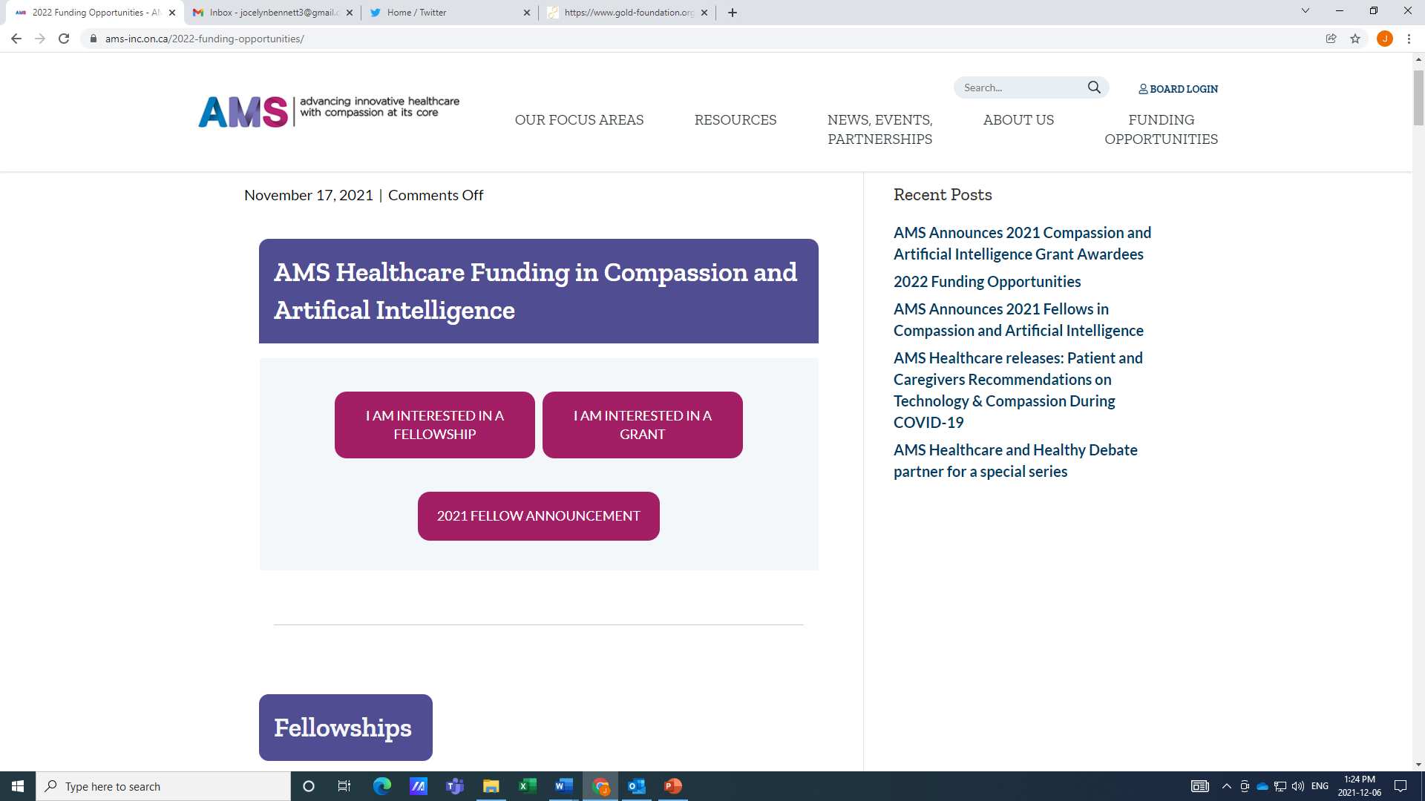
Spend some time on the AMS website!
Overview of funding streams
Eligibility
Key Dates
Resources
  Videos
  Book chapter (downloadable)
  Podcasts
Past Awardees
Links to OSSU
https://www.ams-inc.on.ca/2022-funding-opportunities/
https://www.ams-inc.on.ca/ams-podcast-good-tech-compassionate-healthcare/
Notes:
If you have questions – reach out!

Slide 11
AMS – Fellowship
Develop leaders in all disciplines
Early/mid-career
Award funds may be used to fund career development & projects aligned with AMS’s strategic foci.
Up to 12 awards are available.
Activities with compassion at the core.
Inclusion of patients and caregivers, community and or service end users as advisors to the fellowship. Must provide rational if you are not involving patient/caregiver mentor.
Participation in developmental opportunities over the course of the fellowship (residency, leadership coaching, institute, etc.)
Notes:
Leaders
Early/Mid-career - <5 / 5-15 yrs
Career development & project activities
12 awards
Compassion at core
Patient & caregivers
- Mentor and mentorship plan
- Other engagement activities
Participation in AMS programs

Slide 12
Important Dates
 | Fellowship
Launch | 1-Nov-2023
Information webinar | 22-Nov-2023
LOI Submission Date | 11-Jan-2024
Notification Date | 11-Mar-2024
FA Submission Date | 18-Apr-2024
Notification Date | Jun/Jul-2024

Slide 13
Fellowship LOI Submission
Submission deadline is 5pm Eastern, Thursday, January 11, 2024
**Patient Partnership – Proposal, Signature page, Budget
A complete application includes:
  Completed LOI Submission:
    Non-condensed font
    6 lines/inch
    Standard letter with at least 1/2inch margins
    Consecutively numbered pages
    Your name top-right of each page
    A budget table and justification*
  Completed Signature Page
  Abbreviated curriculum vitae of no more than three (3) pages
  Letter of support: Sponsoring Institution
Notes:
New - Patient Partnership
- still a strong recommendation
- applications are reviewed by patient partners
- Application
- Proposal – background, mentorship plan. If no, provide a justification.
- Signature page – patient/caregiver mentor. If no, provide a justification.
- Budget – compensation (monetary or non-monetary)

Slide 14
Budget Table and Justification

Slide 15
Fellowship LOI Submission
Review Criteria
  Eligibility and relevance
  Merit
    Leadership (potential) (40%)
    Link to compassion (30%)
    Proposed Research Project (15%)
    Training environment (15%)
Notes:
Leadership (potential) (40%) Potential of the applicant as an emerging health services/health systems researcher, a champion of patient partnership and compassion as a service provider, and leader in health, DT/AI in/for healthcare. The application ought to justify a plan for enhancing leadership skills and abilities through the fellowship. This would include a track record as an emerging leader and a plan to enhance leadership skills and abilities through the fellowship.
Link to compassion (30%) - The fellowship proposes to explore a specific attribute(s) of compassion (i.e., provider patient relationship, equity, trust, patient safety, suffering, provider burnout, etc.). - Compassion is clearly conceptualized and defined in the proposal. - The exploration and integration of compassion in relation to digital technology/AI is core to the proposal.
Proposed Research Project (15%). - Quality, potential impact and feasibility of the applicant’s project or work proposal.
Training environment (15%) (consider career stage and discipline of the applicant) - Institution commitment and resource - space, facilities, funding, release time, collaborations, and personnel support - Supervisor/Mentor - commitment, research and content experience, training experience, qualifications, honours and awards, contributions, o Supervision/Mentorship plan - Patient Mentor (including caregivers, community and or service end users)

Slide 16
Notes:
The grant explores specific attribute(s) of compassion (i.e., provider-patient relationship, equity, trust, patient safety, suffering, provider burnout, etc.) in relation to digital technology/AI;
Compassion is clearly conceptualized and defined in the proposal; and
The exploration of compassion in relation to digital technology/AI is core to the proposal.
Compassion is conceived as a state of concern for the suffering or unmet need of another, coupled with the desire to alleviate that suffering [Goetz at al, 2010]. An experience of compassion is defined in this way involves several distinct components:
Awareness of the suffering or needs in another individual,
Feeling moved, and recognizing this as a response to others need,
Appraisal of one’s own feelings, social roles, and abilities within the context of another’s suffering,
Judgement that the other person is suffering,
Engagement in behaviours that drive social affiliation and caregiving and motivate helping and behaviours to alleviate suffering
(NB This definition is meant to guide applicants and reviewers, not serve as a “checklist” for inclusions into the LOI).
From: Seppälä, E.M., Simon-Thomas, E., Brown, S.L., Worline,M.C., Cameron, C.D., and Doty, J.R. (2017). The Oxford Handbook of Compassion Science. Oxford Press. DOI: 10.1093/oxfordhb/9780190464684.001.0001 (p.3)
The AMS Compassion and DT/AI Small Grant Program is expected to:
Support research, knowledge translation and spread and scale activities;
Promote relevant collaborations across disciplines and professions; and,
Engage the healthcare community in the exploration and evaluation of topics related to compassion and technology.

Slide 17
Small Grant Submission
Submission deadline is 5pm Eastern, Wednesday, February 7, 2024
A complete application includes:
  FA Submission
  Signature Page
  5-page CV for each member (PI, co-PIs and Collaborators)
  Sponsor letter
  Collaboration letters (Co-PIs, collaborators and partners)
  Attachment
Notes:
Submission - Deadline is 5pm Eastern, Wednesday February 7, 2024
- All expectations are laid out in the submission guide document, including the word limits and formatting. There needs to be alignment seen between the proposed work, anticipated outcomes, and the goals and objectives of AMS aligned with compassionate care. In the partner description section, there needs to be a description of those engaged, in particular those with lived experience. If you do not have patient, caregiver, or community partners engaged you need to justify why not.
- completed Signature Page, including all team members research and community-based.
- 5-page CV of applicant and each team member (any format, emphasize strengths) – co-PIs, Collabs & partners (N=5)
- Sponsor Letter that emphasizes supports and contributions
- Letters of Collab from team members: co-PIs, Collabs & partners
- Attachment (5 pages)
- Submit by email, 36-hour confirm receipt (no, email me)
Notification - June 2024 by email

Slide 18
Budget Table and Justification
Notes:
The budget needs to be described and justified in application as per the submission guide.

Slide 19
Small Grant Submission
Review Criteria
  Eligibility and relevance
  Merit
    Concept (significance, novelty and potential for impact)
    Feasibility (methods, expertise and budget)
Notes:
To support the objectives of the grant award program, the following criteria will be used.
Have you met the eligibility criteria and relevance criteria as laid out in the call
Concept of the proposal
Proposal addresses the core criteria of the grant program.
The significance, novelty and potential impact of the proposed activities.
Consistency of the proposal with AMS’s Mission, Vision, Goals and priorities.
Likelihood of the proposed activities to broaden knowledge related to DT/AI and compassionate care.
Feasibility of the proposal
Appropriateness and feasibility of the approaches and methods to be used for the proposed activities.
Expertise and experience of the applicant and the team.
Appropriateness of the budget in relation to the proposed activities. (Preference will be given to applications that demonstrate strong partnerships with their home agency and have identified co-funding or in-kind contributions)
Applicants are strongly encouraged to engage patients and caregivers (person with lived experience), community and or service end users as advisors, co-applicants, collaborators or partners to the project and on the team.

Slide 20


